Slide 1
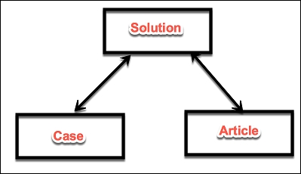
What is Many to many relationship and how to create one?
The many-to-many relationship in Salesforce allows us to link a child record to multiple parents.
If you have two objects, called Case and Article, and you want to relate these two objects in such a manner that one case can have multiple articles and one article is linked to many cases, then we have to use the many-to-many relationship.
The many-to-many relationship is made with the help of a junction object.
In this case, we can create the third object, let's say, Solution with two master-detail relationships with Solution - Case and Solution - Article.

